Slide 1
Introduction to Business Analytics
Presented by: Dr. Stern, Director of Business Analytics Undergraduate Degree

Slide 2
Learning Objectives
Define business analytics (BA) and explain what knowledge is needed for BA.
Explain the advantages of structured data over unstructured data.
Describe the different column/variable types.
Know the business analytics workflow.
Application: Google Sheets.

Slide 3
What is Business Analytics?
Using data to drive business insights and aid in decision making
BA is NOT about product development
Often, BA is used to complete a traditional business function (e.g., finance, accounting, marketing) with cutting edge data analysis techniques
BA requires both qualitative reasoning and quantitative analysis

Slide 4
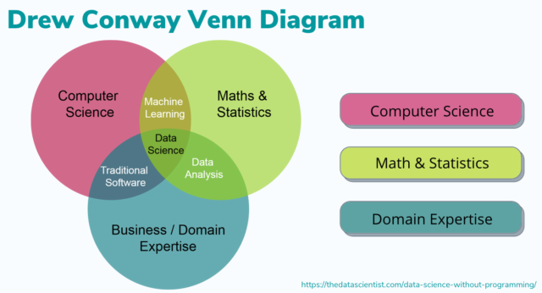
What is Business Analytics?

Slide 5
Example Applications of BA
The Gap Inc. The Gap’s CEO revolutionized the company by using analytics to identify loyal customers, match products to customers, enhanced customer satisfaction, and manage product rebuys.
Netflix. Netflix uses data analytics to recommend content to its users.
The Oakland Athletics. The A’s used analytics to greatly outperform relative to its small budget. The story of the A’s success was depicted in the movie Moneyball.

Slide 6
Data Types
Unstructured data
Semi-structured data
Structured data

Slide 7
Example: Unstructured Data
Emails, essays, notes taken during a meeting, text from a social media post, videos, pictures.
Unstructured data can contain information, but it is challenging to extract.

Slide 8
Example: Semi-structured Data
{ "socialMediaPosts": [
{ "postId": "12345",
"user": { "userId": "u1001", "username": "user_01", "profilePicture": "profile_pic_01.jpg" },
"content": "Loved the sunset at the beach today! #NatureBeauty", "timestamp": "2024-01-08T17:30:00Z", "image": "sunset_beach.jpg", "likes": 152,
"comments": [
{ "commentId": "c1001", "userId": "u1050", "text": "Wow, that looks amazing!", "timestamp": "2024-01-08T17:45:00Z" },
{ "commentId": "c1002", "userId": "u1033", "text": "I wish I was there!", "timestamp": "2024-01-08T18:05:00Z" } ] }, …

Slide 9
Example: Semi-structured Data
It is easier to extract information from semi-structured data than unstructured data because there is some level of organization.
But it is still challenging.

Slide 10
Example: Structured Data

Slide 11
Example: Structured Data
name | class | gpa | major
Joe | Freshman | 3.8 | BUA
Sally | Freshman | 3.0 | ACC
Jose | Junior | 3.7 | FIN
Chad | Senior | 2.3 | MRKT
Tina | Sophomore | 3.9 | MGMT
Jim | Sophomore | 2.0 | MGMT
Table or data frame

Slide 12
Example: Structured Data
name | class | gpa | major
Joe | Freshman | 3.8 | BUA
Sally | Freshman | 3.0 | ACC
Jose | Junior | 3.7 | FIN
Chad | Senior | 2.3 | MRKT
Tina | Sophomore | 3.9 | MGMT
Jim | Sophomore | 2.0 | MGMT
Column or variable

Slide 13
Example: Structured Data
name | class | gpa | major
Joe | Freshman | 3.8 | BUA
Sally | Freshman | 3.0 | ACC
Jose | Junior | 3.7 | FIN
Chad | Senior | 2.3 | MRKT
Tina | Sophomore | 3.9 | MGMT
Jim | Sophomore | 2.0 | MGMT
Row or observation

Slide 14
Column/Variable Types
Categorical:
Color (green, yellow, …)
High school class (freshman, sophomore, …)
Shirt size (small, medium, …)
Numeric:
Height (in inches)
Revenue (in dollars)
Population (in thousands)
Dates:
MM/DD/YYYY
YYYY-MM-DD

Slide 15
Business Analytics Workflow
Problem identification
Collect and import data
Identify and handle missing and unusual values
Explore data with summary measures and graphics
Model data
Interpret and communicate results

Slide 16
Activity
Problem identification: An online marketplace wants to understand customer spending by demographics to target customers with promotional pricing.

Slide 17
Time for an activity!
Download the Customer Spending Data from GitHub:
https://github.com/mattstern2/BUA301/blob/main/Customer%20Spending%20Data.xlsx

